Slide 1
Causal diagrams for understanding when correlations doesn’t imply causation
Translational Clinical Oncology
Pharmacometrics
Andy Stein
October 13, 2021

Slide 2

Who am I? Andy Stein
Group: Pharmacometrics
What I do:
Support quantitative analysis of early clinical trials, with a focus on identifying the right dose.
My background:
Mechanical Engineering and Applied Mathematics
My passion:
Learning and bringing insights from other fields into drug development and vice versa (environmental modeling, managing uncertainty, parenting)

Slide 3
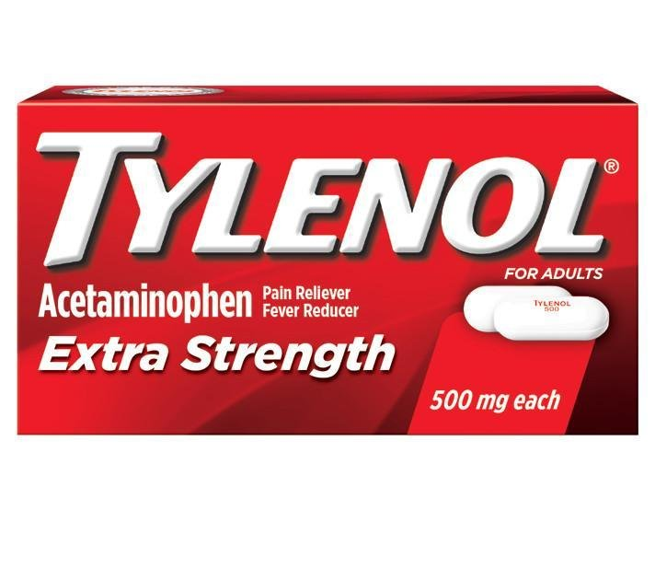

Motivation – the importance of finding the right dose of a drug
Tylenol helps to reduce pain and fever and is safe at daily doses ≤3,000 mg/day
>5,000 mg/day can cause liver damage
>10,000 mg/day can be lethal.
You can learn about safety and efficacy from clinical trials
Making best use of this data requires models to integrate the data
(paracetamol)
Notes:
You can learn a

Slide 4
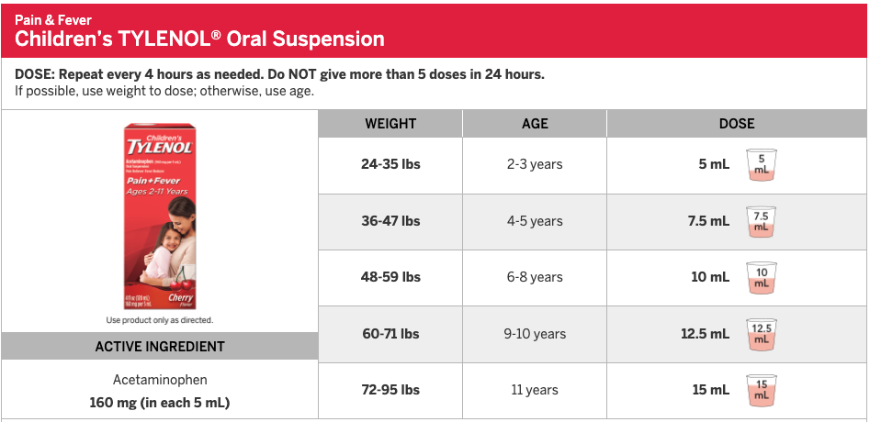
Understanding which factors to control for (age) is critical

Slide 5
Overview
Situation:
We use models relating drug concentration to response to guide drug development.
Models are useful when they describe a causal relationship
If relationships are only correlative relationship, they can lead to poor decisions
Question: How to assess whether a relationship is causal or just correlative?
Answer: Causal diagrams can help identify confounders
Outline
Introduce PKPD concepts and exposure-response modeling
Present two examples of exposure-response confounding
Introduce causal diagrams and their key structures
Conclude with COVID-19 example

Slide 6
The “PKPD” pathway of drug effect
Absorbed by intestines into blood
Distribute from blood into tissue
Binds target in tissue
Effects
Oral Dose
Drug Concentration
Measurement
Elimination
from body
Pharmacokinetics (PK):
How body affects drug
Pharmacodynamics (PD):
How drug affects body
Should children and adults receive the same dose?
What dose is needed to shrink a tumor without causing severe neutropenia

Slide 7
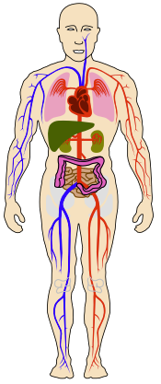
Measuring PKPD
Dose Regimen
amount given
frequency
method (oral, patch, etc.)
PK (Pharmacokinetics) example
Measurement of drug concentration from circulation
PD (Pharmacodynamics) example
Change in tumor size, as measured by X-Ray

Slide 8
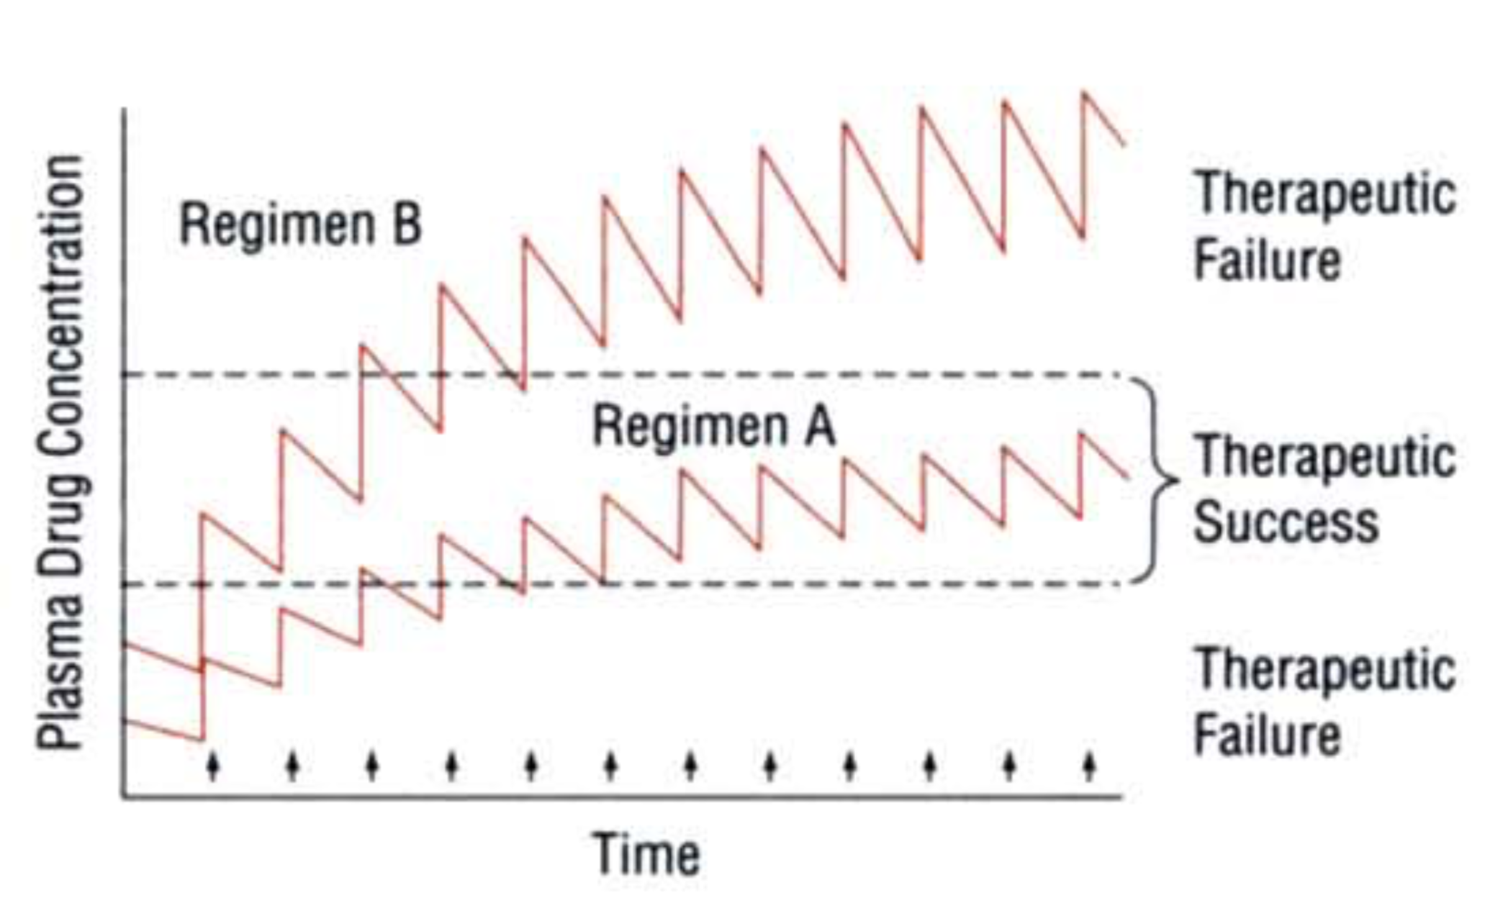
Understanding PKPD can help in picking the optimal dose regimen
Drug is too toxic
Drug doesn’t work
From Rowland and Tozer

Slide 9
Novartis was developing a PD-L1 Inhibitor. Other PD-L1 drugs on the market
Atezolizumab dosed at 1200 mg q3w
Our drug had similar properties to atezolizumab
Is 1200 mg q3w the right dose for us?

Slide 10
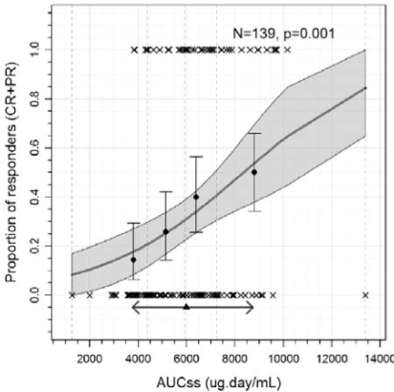
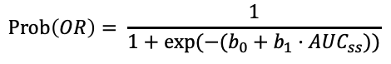
Higher exposure of atezolizumab correlates with better response
1
0.8
0.6
0.4
0.2
0
Atezolizumab, 1200 mg q3w
Only one dose tested
2nd Line Non Small Cell Lung Cancer (NSCLC)
Probability of Overall Response
$$Prob\left(OR\right)= \frac{1}{1+exp⁡({−(b}_{0}+b_{1}·AUC_{ss}))}$$
2 4 6 8 10 12
AUCss (mg·day/ml)
= steady state drug conc. * 21 days
From Feb 2016 FDA Clin. Pharm. Review

Slide 11
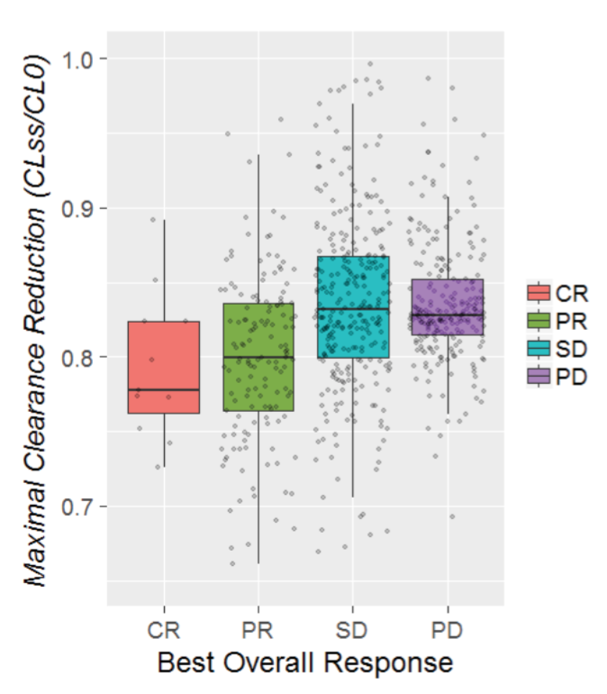
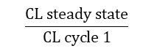
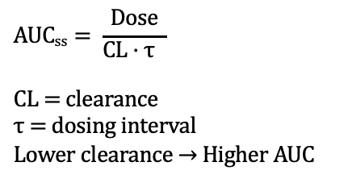
Clearance decreases (and exposure increases) with improved response¹⁻²
Atezolizumab in NSCLC
(observed for most PD-1, PD-L1 inhibitors)
$$AUCss= \frac{Dose}{CL \text{· }\text{τ} }$$
CL = clearance
τ = dosing interval
Lower clearance → Higher AUC
$$\frac{CL steady state}{CL cycle 1}$$
Complete Response
Partial Response
Stable Disease
Progressive Disease
Cachexia in non-responders might lead to faster clearance of drug³
Liu, Chao, et al. "Association of Time‐Varying Clearance of Nivolumab With Disease Dynamics and Its Implications on Exposure Response Analysis." Clinical Pharmacology & Therapeutics 101.5 (2017): 657-666.
FDA Clin Pharm Review for atezolizumab in NSCLC (2016)
Bajaj, G., et al. "Model‐based population pharmacokinetic analysis of nivolumab in patients with solid tumors." CPT: pharmacometrics & systems pharmacology 6.1 (2017): 58-66.

Slide 12
Exposure drives response AND response drives exposure
1
0.8
0.6
0.4
0.2
0
Assumption
Dose
Exposure
Response
Probability of Overall Response
Reality
(sometimes)
Dose
Exposure
Response
2 4 6 8 10 12
AUC_{ss} (mg·day/ml)

Slide 13
Prognostic factors may also confound the analysis
Assumption
Dose
Exposure
Response
Reality
(sometimes)
Dose
Exposure
Response
Prognostic
Factors
- Patient health
- metastases
- cachexia

Slide 14
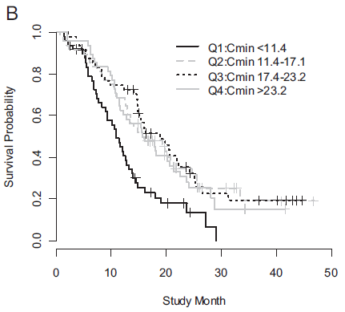
For trastuzumab in metastatic Gastric Cancer, exposure-OS relationship observed
Trough conc. at end of day 21 (model predicted)
Q2, Q3, Q4
Q1
Yang, Jun, et al. "The combination of exposure‐response and case‐control analyses in regulatory decision making." The Journal of Clinical Pharmacology 53.2 (2013): 160-166.

Slide 15
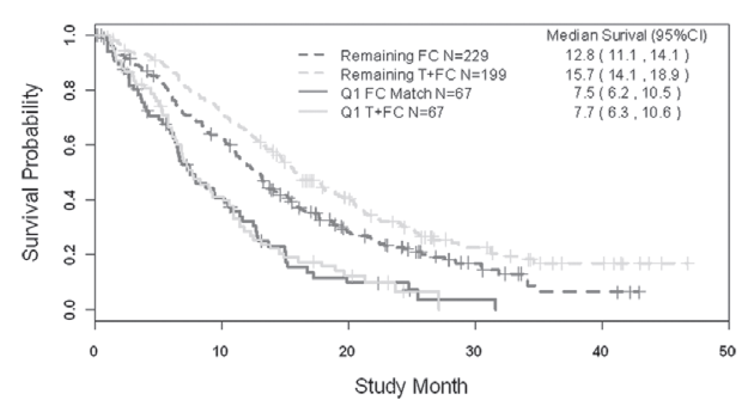
Poor response at Q1 exposure was due to prognostic factors affecting both exposure and response¹
Key prognostic factors
ECOG
Prior gastrectomy
# metastatic sites
Asian ethnicity
HER2 IHC score
Trastuzumab Q2-4
Control Arm Subset
Matched baseline char. to Q2-4 pts
Trastuzumab Q1
Control Arm Subset
Matched baseline char. to Q1 pts
Yang, Jun, et al. "The combination of exposure‐response and case‐control analyses in regulatory decision making." The Journal of Clinical Pharmacology 53.2 (2013): 160-166.

Slide 16
Draw a causal graph of the dose-exposure-biomarker-resp. relationship

Slide 17

Fork: you must stratify by covariate, otherwise estimated E-R relationship will not be causal
Dose
Exposure
Response
Covariate
Simpson’s Paradox:
https://en.wikipedia.org/wiki/Simpson%27s_paradox

Slide 18
Mediators and Colliders: you must not stratify by covariate, otherwise E-R will be confounded [these are post-baseline covariates]
Mediator
Dose
Exposure
Response
Covariate
Collider
Dose
Exposure
Response
Covariate

Slide 19

Feedback Loop: You must think about the consequences of the feedback loop(s) and choose the appropriate analysis.
Dose
Exposure
Response
Using dose or exposure only at day 1 help avoid confounding.
https://arxiv.org/abs/1907.07271

Slide 20
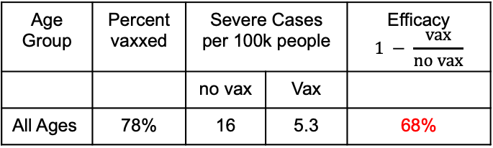
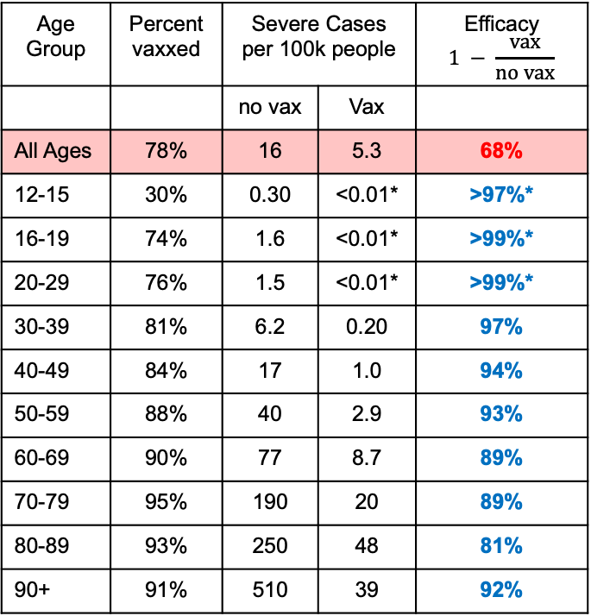
COVID-19 example
Age Group | Percent vaxxed | Severe Cases per 100k people |  | Efficacy $$1 − \frac{vax}{no vax}$$
 |  | no vax | Vax
All Ages | 78% | 16 | 5.3 | 68%
12-15 | 30% | 0.30 | <0.01* | >97%*
16-19 | 74% | 1.6 | <0.01* | >99%*
20-29 | 76% | 1.5 | <0.01* | >99%*
30-39 | 81% | 6.2 | 0.20 | 97%
40-49 | 84% | 17 | 1.0 | 94%
50-59 | 88% | 40 | 2.9 | 93%
60-69 | 90% | 77 | 8.7 | 89%
70-79 | 95% | 190 | 20 | 89%
80-89 | 93% | 250 | 48 | 81%
90+ | 91% | 510 | 39 | 92%
Age Group | Percent vaxxed | Severe Cases per 100k people |  | Efficacy $$1 − \frac{vax}{no vax}$$
 |  | no vax | Vax
All Ages | 78% | 16 | 5.3 | 68%
All Ages | 78% | 16
12-15 | 30% | 0.30
16-19 | 74% | 1.6
20-29 | 76% | 1.5
30-39 | 81% | 6.2
40-49 | 84% | 17
50-59 | 88% | 40
60-69 | 90% | 77
70-79 | 95% | 190
80-89 | 93% | 250
90+ | 91% | 510
Get
Vaccine
Hospitalization
Due to COVID-19
Age
Reason for confounding: Older people are both more likely to be vaccinated and more likely to be hospitalized, irrespective of vaccination.
https://www.covid-datascience.com/post/israeli-data-how-can-efficacy-vs-severe-disease-be-strong-when-60-of-hospitalized-are-vaccinated Israel data with Pfizer Vaccine, August 2021
* Andy’s guess for upper level of quantification

Slide 21
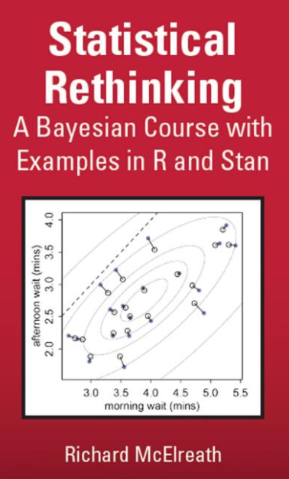
Drug development is challenging because biology is so complex
Causal diagrams can help by identifying potentially confounding factors
Forks
Feedback Loops

Slide 22
Acknowledgements
Exposure-Response Guidance Team
Thomas Dumortier
Guenter Heimann
Yu-Yun Ho
Alison Margolskee
Oliver Sander
Marina Savelieva-Praz
Xinrui Zhang
Analytics colleagues
Mark Baille
Bjorn Bornkamp
Christian Bartels
External Colleague
Mike Perry

